Slide 1
Getting More from
MS PowerPoint
Notes:
MS PowerPoint Training Handbook
© AIG Systems Solutions
Employee Name:
Trainer Name:
Date of Training:

Slide 2
Session 2
Notes:
MS PowerPoint Training Handbook
© AIG Systems Solutions

Slide 3
Objective
This session covers creation of templates and the use of Slide Master designs to make overall changes to presentations, the use of hyperlinks to slides within a presentation and to external files or Websites, the application of animation effects to slides and text, and tools for rehearsing and controlling the delivery of presentations.
Notes:
MS PowerPoint Training Handbook
© AIG Systems Solutions

Slide 4
Making overall changes to your Presentation
Slide Masters
The Slide Masters contain a background design and default text formatting for the slide titles and other text items. They can also contain graphics (such as company logos), and footer information such as slide numbers and the date. Shortcut: Shift key + Click on Normal View Icon
Headers and Footers
These contain information that appears on every slide, such as the presentation title and date, or the slide number.
Design Templates
Also referred to as Designs, these contain predefined colour schemes and graphics, and text layout and formatting choices. You can create your own template, or apply one of PowerPoint's off-the-peg designs.
Notes:
MS PowerPoint Training Handbook
© AIG Systems Solutions

Slide 5
Making overall changes to your Presentation …Contd.
Colour Schemes
PowerPoint offers a selection of background colours and complementary text and drawing colours. You can choose one of the predefined schemes, or create you own.
The following sections cover these in turn
Backgrounds
Backgrounds of various forms or an image could be set as the background.
Removing different backgrounds
In order to remove a texture fill effect, and perhaps replace it with a standard colour scheme, you must firstly replace the fill with a solid plain colour using the Background window. Only then will you be able to apply one of the preset colour schemes.
Notes:
MS PowerPoint Training Handbook
© AIG Systems Solutions

Slide 6
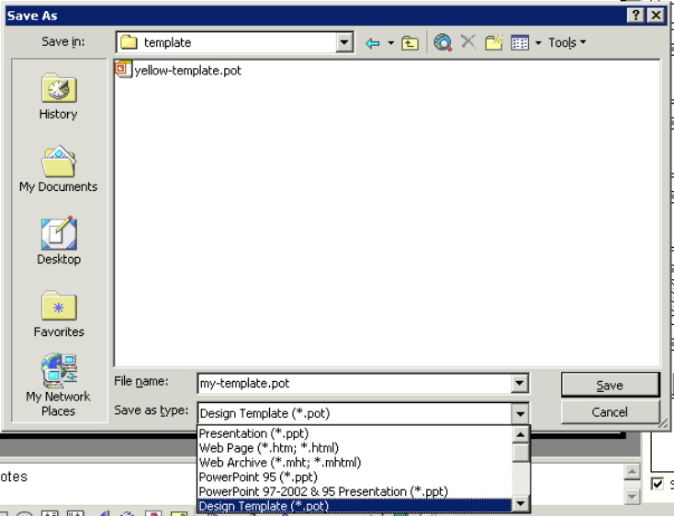
Creating Design Templates
To create a Design Template:
  Open the presentation on which you want to base your template, or start a new presentation and make any changes to the colour scheme or design.
  Edit the Slide Master to define the appearance of text, include logos, or add header/footer information.
  Close the Slide Master to return to Normal View.
  Delete any existing slides/text (unless you want them to appear in every presentation based on this template).
  Choose File | Save As.
Notes:
MS PowerPoint Training Handbook
© AIG Systems Solutions

Slide 7
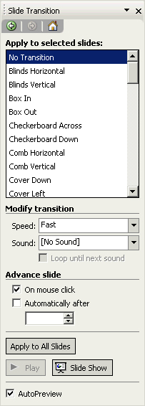
Applying Slide Transitions
Transitions determine how a slide appears on screen.
Applying appropriate Transition Effect in Slides
Using the Slide Sorter View
Using the Normal View - Menu Slide Show | Slide Transition
Using the Slide Transition Task Pane
Notes:
MS PowerPoint Training Handbook
© AIG Systems Solutions

Slide 8
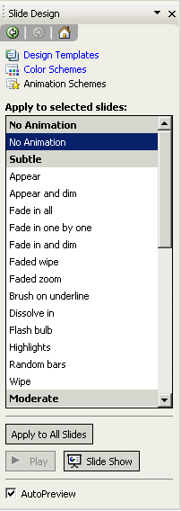
Applying Animations or Builds
Animations (known as Builds in older versions of PowerPoint) apply to the content of slides. Animations may be applied to the current slide, to all slides, or to selected slides.
Using the Slide Design – Animation Schemes Task Pane
Using Slide Show Menu
Custom Animation
To Remove an Animation
Click on the No Animation option (at the top of the list)
Click Apply to All Slides unless you only wish to remove the effect from
the current or selected slides.
Notes:
MS PowerPoint Training Handbook
© AIG Systems Solutions

Slide 9
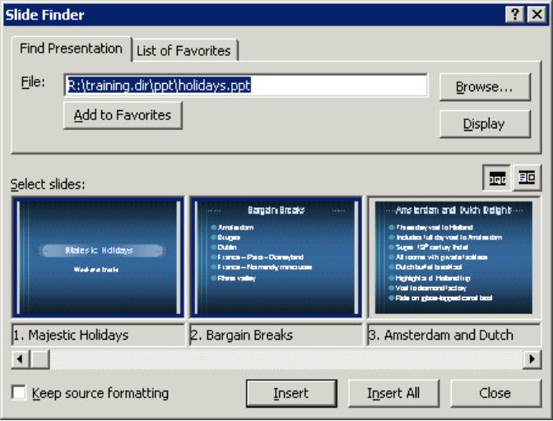
Inserting slides from another presentation or outline
Slides from Files
You can insert slides from another presentation into the one in which you are working in very easily. To do this:
  From the Insert menu choose Slides from Files
  The Slide Finder window appears. Click the Browse button and choose the PowerPoint file containing the slides you wish to include
  Select individual slides by clicking on them and click Insert (or Insert All if you want to insert them all)
Notes:
MS PowerPoint Training Handbook
© AIG Systems Solutions

Slide 10
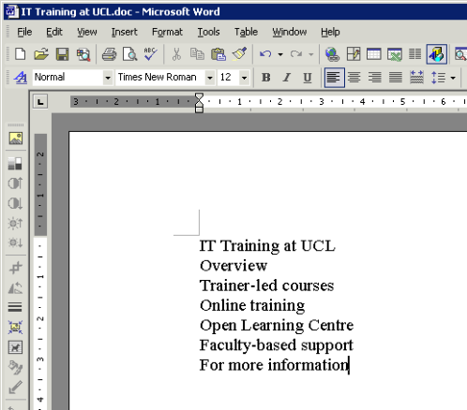
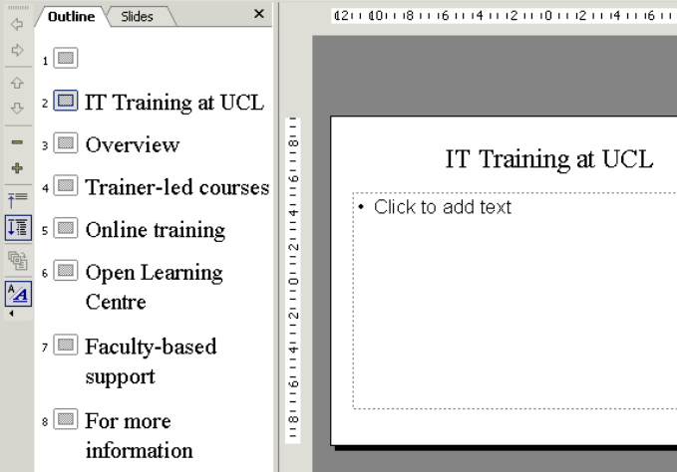
Inserting slides from another presentation or outline …Contd.
Slides from Outline
You can also insert outlines (lists created in Word, Excel or using a simple text editor) individual items on the list become titles of individual slides when inserted in this way.
  From the Insert menu choose Slides from Outline.
  An Insert Outline dialog box appears – choose the file containing the list of items which you want to use as slide titles.
Notes:
MS PowerPoint Training Handbook
© AIG Systems Solutions

Slide 11
Hyperlinks
PowerPoint Hyperlinks allow you to branch off during your presentation to a variety of locations. You can create a hyperlink to take you to a specific slide within your presentation, a Custom Show, or another presentation altogether.
You can link to a Word document, an Excel spreadsheet, or the Internet. You can create a hyperlink from any text or object.
Text that represents a hyperlink appears underlined and in a colour that co-ordinates with the colour scheme. The colour changes after you jump from a hyperlink, so you can tell which hyperlinks you've already viewed. If you have text within a shape, you can set up separate hyperlinks for the shape and the text.
You can set it so that either clicking on the hyperlink, or holding the mouse over it, activates the hyperlink. You can also associate two actions with the text or object. For example, you can move the mouse over an object to play a sound and then click the object to jump to another slide.
Hyperlinks only become active when you run your slide show, not when you are creating the show.
Notes:
MS PowerPoint Training Handbook
© AIG Systems Solutions

Slide 12
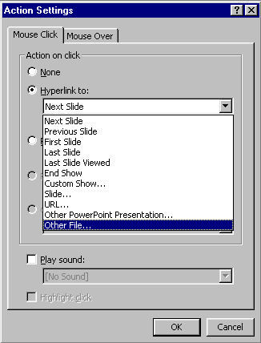
Hyperlinks
Creating a hyperlink
Ensure that the presentation in which you want to insert the Hyperlink has been saved. You cannot create a relative link if you insert the hyperlink before the presentation is saved.
To another slide in the slide show
To another presentation / Slide Show
To other files
To an URL
To End the show (Control the Show)
Notes:
MS PowerPoint Training Handbook
© AIG Systems Solutions

Slide 13
Hyperlinks
Editing a hyperlink
To edit a hyperlink:
In Normal View, select the text or object that represents the hyperlink you want to edit.
From the Slide Show menu, select Action Setting.
Make the changes you want, then click OK.
Removing a hyperlink
To remove a hyperlink:
In Normal View, select the text or object that represents the hyperlink you want to remove.
From the Slide Show menu, select Action Setting.
Click None, then click OK.
Or
Place the cursor at the end of the hyperlink and click Backspace key.
Notes:
MS PowerPoint Training Handbook
© AIG Systems Solutions

Slide 14
Custom Shows
PowerPoint's Custom Shows feature allows you to create a presentation within a presentation. Instead of creating multiple, nearly identical presentations for different audiences, you can group together and name the slides that differ and then jump to these slides during your presentation.
For example, you might want to give a presentation to two groups that work at two different sites. The slide show includes slides 1 through 10, which are identical for both groups, and two Custom Shows, each specific to one of the sites.
You can show the first 10 slides to both groups and then jump to a Custom Show named "Site 1" for the first group and to a Custom Show named "Site 2" for the second group.
You can jump to a Custom Show by using the Action Settings dialog box (Slide Show menu) to set up a hyperlink to the show. Or, during a presentation, you can right-click, point to Go on the shortcut menu, point to Custom Show, and then click the show you want
Notes:
MS PowerPoint Training Handbook
© AIG Systems Solutions

Slide 15
Controlling a Presentation
F5 – From Start of the Presentation
Shift +F5 – Current Slide
Saving a Presentation
.ppt – PowerPoint Presentation file
.pps – PowerPoint Slide Show (exe)
.pot – PowerPoint Template
Hiding a Slide
Slide Show Menu | Hide Slide
Notes:
MS PowerPoint Training Handbook
© AIG Systems Solutions

Slide 16

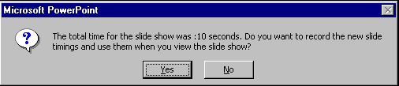
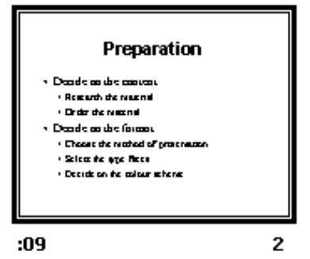
Rehearsing Timings
Slide Show | Rehearse Timings
Time elapsed for current slide
Running the timed slide show
Slide Show | View Show
The show will run from the first to the last slide automatically, at the rate determined by the recorded times.
To stop the show before the end, press the Esc key.
To turn off the automatic timings on the Slide Show menu click Set Up Show and choose to advance slides manually
Play button
Time elapsed for whole show
Pause button
Recorded timing
Notes:
MS PowerPoint Training Handbook
© AIG Systems Solutions

Slide 17
Slide Show controls
To | Do this
Advance to the next slide | Click the mouse
Return to the previous slide | Press Backspace
Go to a slide | Type the slide number, and then press Enter
Black or unblack the screen | Press B
White or unwhite the screen | Press W
Show or hide the arrow pointer | Press A
Stop/Restart Automatic Show | Press S
End slide show | Press Esc
Erase drawing on-screen | Press E
Go to next slide, if it's hidden | Press H
Rehearse with new timings | Press T
Rehearse with original timings | Press O
Rehearse with mouse-click advance | Press M
Return to the first slide | Hold both mouse buttons down for 2 seconds
Change pointer to pen | Ctrl+P
Change pen to pointer | Ctrl+A
Hide pointer and button | Ctrl+H
Hide pointer and button always | Ctrl+L
Display shortcut menu | Right mouse-click
Notes:
MS PowerPoint Training Handbook
© AIG Systems Solutions

Slide 18
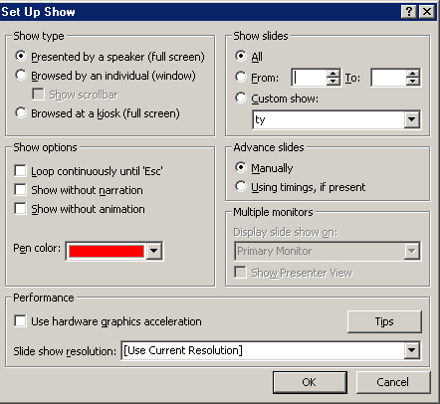
Self-running Presentations
Slide Show | Set Up Show
Notes:
MS PowerPoint Training Handbook
© AIG Systems Solutions

Slide 19
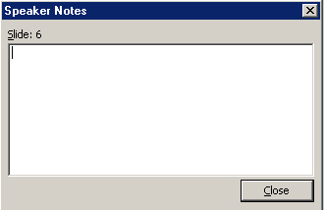
Creating notes during a slide show
During a slide show, click the right mouse button, and then select Screen / Speaker Notes
Type in the space provided on the tab and click Close.
Notes:
MS PowerPoint Training Handbook
© AIG Systems Solutions
Demo for Notes

Slide 20
Activity
Create a PowerPoint presentation specific to any topic in your project / work incorporating all the features learned in Session 1 and Session 2.
Evaluation Criteria
Professional Flow of the presentation
Usage of appropriate features.
Choice of using appropriate features. (Shortcut, Menu, Task Panes, etc)
Explanation of the same.
Minimum of 10 slides to be present.
Notes:
MS PowerPoint Training Handbook
© AIG Systems Solutions

Slide 21
Thank You
Notes:
MS PowerPoint Training Handbook
© AIG Systems Solutions

